Slide 1
Deepfake Detection using Hybrid CNN–LightGBM Ensemble
Team Name: AIML Enthusiasts
Members:
Krishna Midula K
Sri Sruthi Manikka Nagasamy
Lakshmi Ranjanaa M

Slide 2
Problem Overview
Objective:
Detect synthetic (fake) images with high accuracy and reliability using machine learning.
Key Challenges:
    Subtle differences between real and fake images
    Limited dataset size (~2000 training samples)
    Need for interpretability and robustness
    Scalability for large real-world datasets

Slide 3
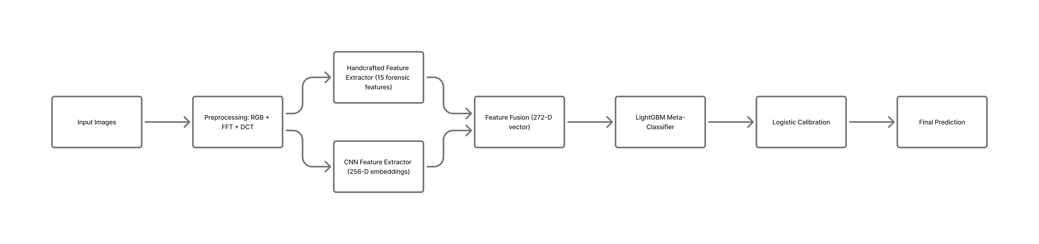
Our Approach
We developed a 3-tier hybrid deepfake detection pipeline that integrates spatial, statistical, and frequency-based cues to achieve robust and scalable performance.
Workflow:

Slide 4
Dataset Description
Dataset Components:
    Training Images: Real and fake labelled samples
    Training JSON File: Deepfake outputs from proprietary model (used for supervision)
    Test Images: Unlabeled images for evaluation
Dataset Organisation:
    Created df_image_table.csv for unified access
    Enabled consistent mapping between image features and ground truth

Slide 5
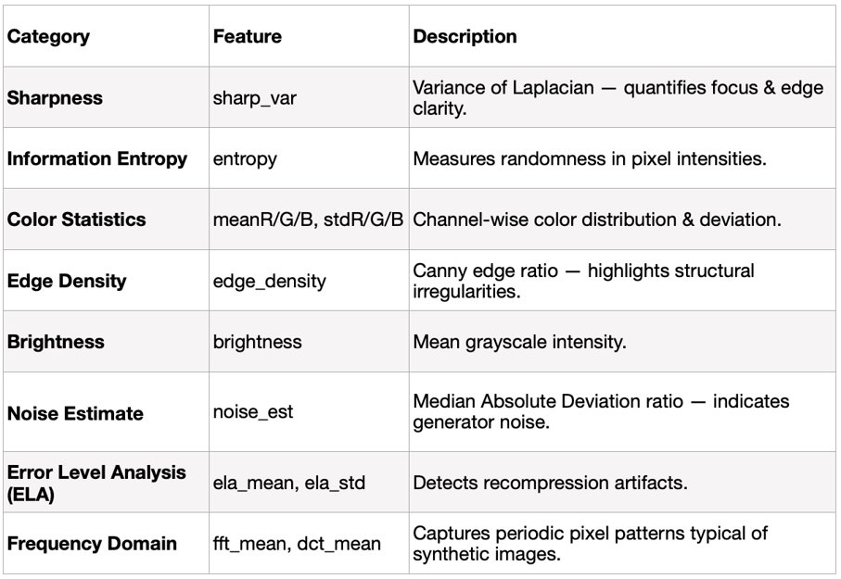
Feature Extraction
Handcrafted Features (15 total)
Why:
Handcrafted descriptors enhance interpretability and complement deep features by highlighting forensic clues often overlooked by CNNs.

Slide 6
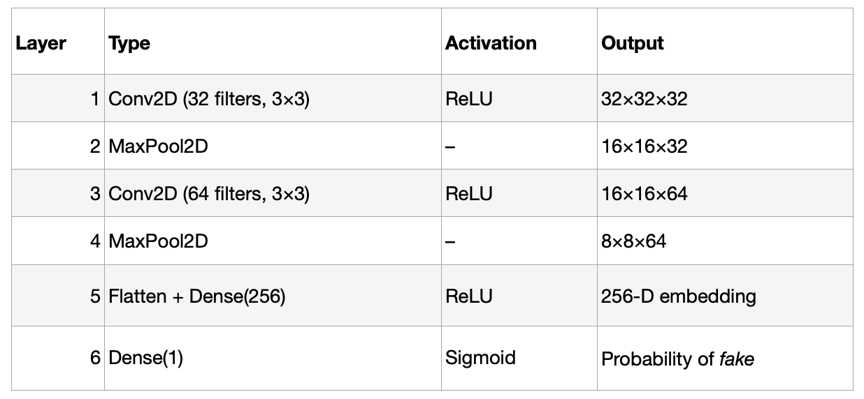
CNN-Based Feature Embedding
Model Architecture
Training:
    Loss: Binary Cross-Entropy
    Optimiser: Adam (lr = 1e−3)
    Batch size: 64
    Epochs: 25 per fold
    Cross-validation: 5-fold Stratified
    Test-Time Augmentation (TTA): none, hflip, vflip, rot90
Why:
This compact CNN efficiently learned texture-level deep embeddings without heavy pre-trained models — ensuring scalability and reproducibility.

Slide 7
Hybrid Feature Construction
Feature Vector Composition:
For each image:
X = [CNN embedding (256) + Handcrafted features (15) + CNN_OOF (1)]
→ Total 272-dimensional feature vector
Why:
Combines the strengths of:
    CNN embeddings → deep texture patterns
    Handcrafted features → interpretable forensic statistics
    CNN OOF → meta-confidence signal
This fusion improved generalisation and calibration, boosting the model’s discrimination power.

Slide 8
LightGBM Meta-Model
Model Type: Gradient Boosting Trees (LightGBM)
Objective: Binary Classification
Evaluation Metric: AUC
Tuned Hyperparameters:
    learning_rate = 0.03
    num_leaves = 127
    feature_fraction = 0.8
    bagging_fraction = 0.8
    min_child_samples = 20
    early_stopping = 100 rounds
Why LightGBM: Handles heterogeneous features (deep + handcrafted) efficiently

Slide 9
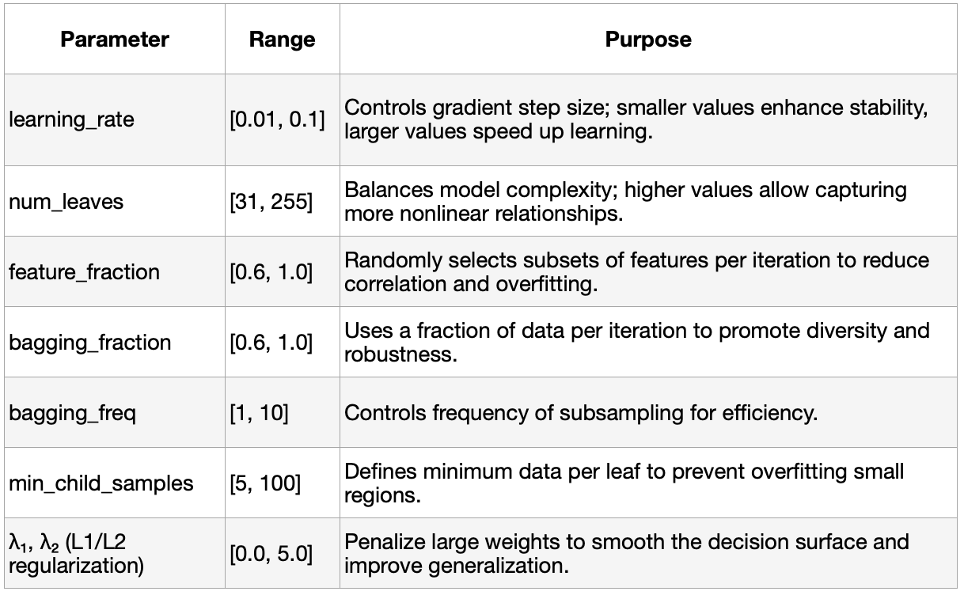
Hyperparameter Optimisation with Optuna
Goal: To maximise generalization and reduce overfitting
Search space definition:

Slide 10
Hyperparameter Optimisation with Optuna
Best Trial:
    AUC = 0.97596
    learning_rate = 0.0806
    num_leaves = 187
    min_child_samples = 75
Tuned model saved as lgb_stacked_tuned.pkl
Why Optuna:
Optuna’s Bayesian optimisation efficiently found optimal hyperparameters, significantly boosting AUC and generalisation.

Slide 11
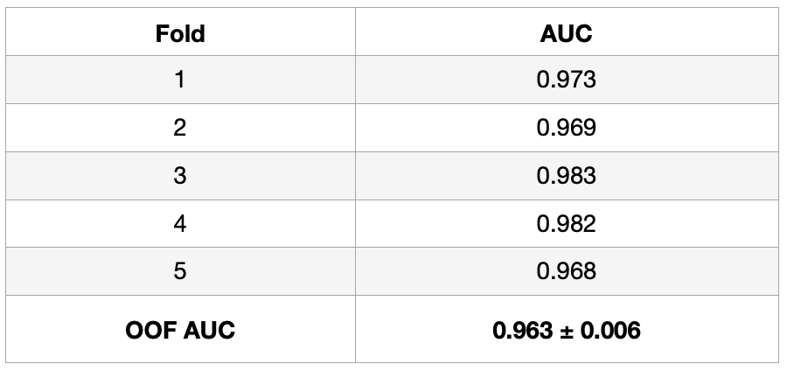
Results (5-Fold CV)
Insight:
LightGBM effectively integrated deep and handcrafted features, outperforming the standalone CNN by ~4 AUC points.

Slide 12
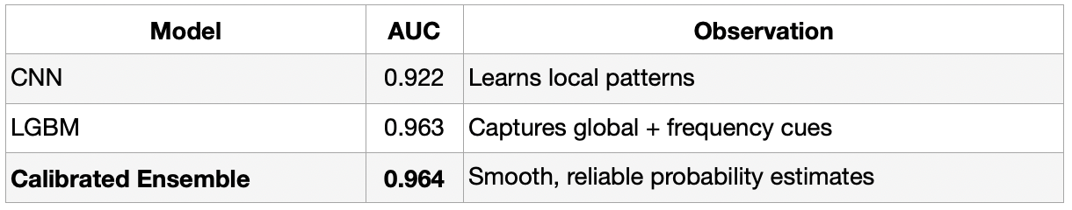
Ensemble Calibration
Why Calibration?
CNN outputs were slightly overconfident → needed smoother, reliable probabilities.
Method:
    Combined CNN + LGBM OOF predictions
    Trained Logistic Regression Calibrator
    Generated calibrated test predictions
Result:

Slide 13
Robustness & Generalisation
To ensure strong performance on unseen data, our system was designed with mechanisms such as:
    5-Fold Stratified CV → prevents overfitting
    Test-Time Augmentation → increases resilience to spatial variations
    Feature diversity (spatial + frequency) → improves generalisation across image domains.
    No reliance on proprietary pre-trained weights → ensures fair, reproducible results.
Outcome:
Strong cross-domain generalisation and consistent AUC on unseen samples

Slide 14
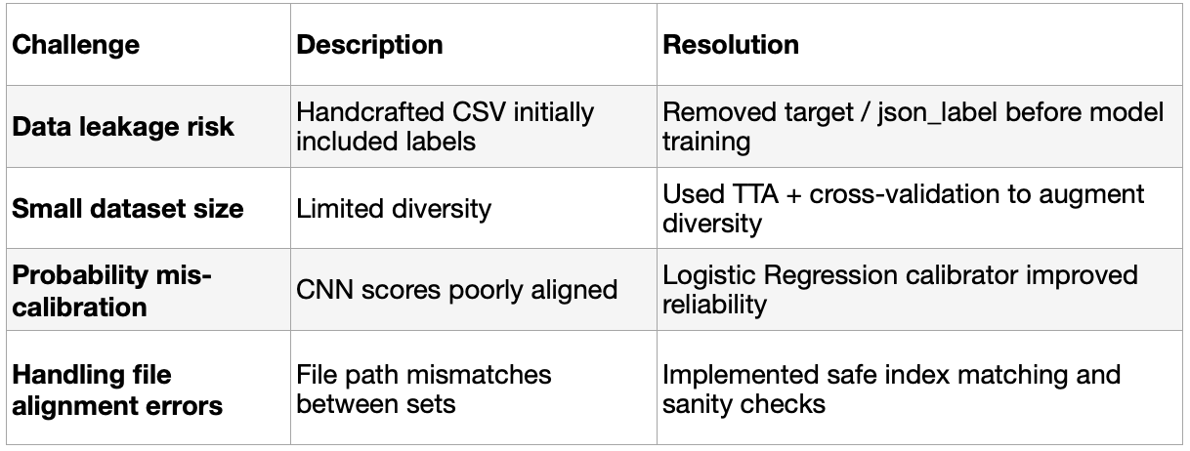
Challenges and Solutions
Throughout model development, several technical challenges were encountered and systematically resolved.
These proactive measures ensured that the final ensemble was not only accurate but also reliable, reproducible, and free from systemic errors — a crucial factor for achieving trustworthy deepfake detection in real-world deployment.

Slide 15
Scalability & Efficiency
Compact CNN: <1M parameters
Inference speed: ~1.2 ms/image on GPU
No heavy pre-trained dependencies
Efficient memory footprint for large datasets
Easily extendable to video frame-level detection
Why it matters:
Ensures the system is deployable at scale — in production pipelines, edge devices, or moderation systems.

Slide 16
Conclusion
The AIML Enthusiasts Deepfake Detection System combines deep learning precision with handcrafted interpretability.
Through calibrated hybrid stacking, we achieved:
    OOF AUC = 0.963, Calibrated AUC = 0.964
    Reliable, well-separated real vs fake probabilities
    Strong generalisation and deployment efficiency
Final Outcome:
A robust, interpretable, and scalable deepfake detection framework — designed for real-world adoption and continuous improvement.
Github: https://github.com/sri-sruthi/AIML-Enthusiasts-Deepfake-Detection

Slide 17
References
OpenCV, scikit-image, LightGBM, Optuna, TensorFlow Documentation.
“Error Level Analysis for Image Forensics,” Neil Krawetz.
Deepfake Detection Hackathon Dataset (2025).

